Slide 1











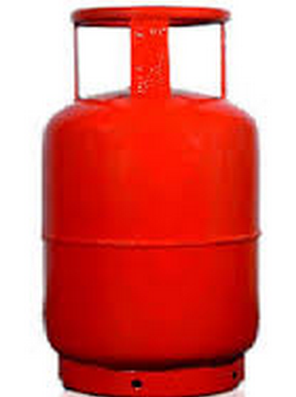
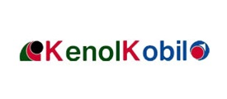

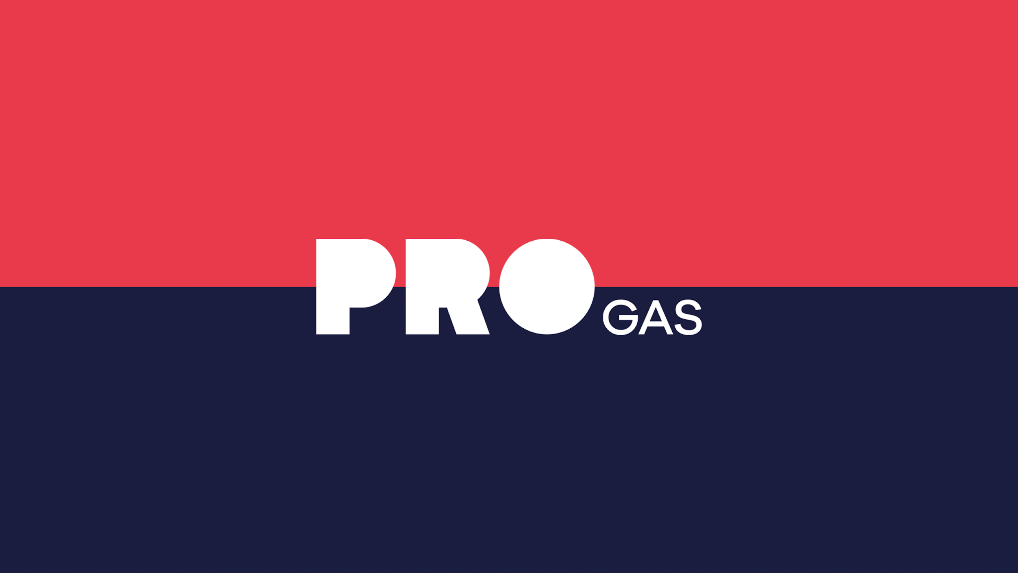

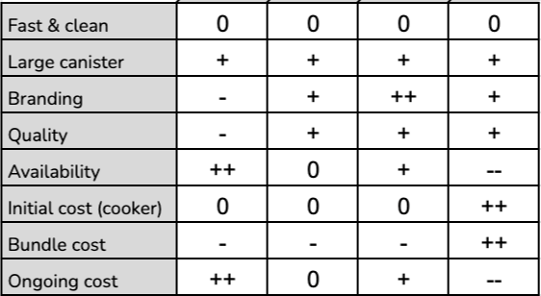
KOKO Fuel Product Vision Board
TARGET GROUP Households in urban areas with monthly incomes of 50k or less, who cook with kerosene, charcoal, or single burner gas They can be split into two market segments: SAM-G (income of 30-50K) with KOKO positioning as a challenger to LPG SAM-K (income of 10-30K) positioning us as an upgrade to kerosene as primary fuel | NEEDS For kerosene users: A safer, healthier, cleaner, more enjoyable cooking experience For gas meko users: Affordability, safety (e.g. unsafe canisters), and convenience For charcoal users: Cleaner, healthier, and more affordable | PRODUCT | BUSINESS GOALS Grow the customer base to 330,000 Sell 15m litres of fuel 1,050 KPs across Nairobi & Mombasa Reduce CAC to $11 Improve customer experience through improved refill and payment journeys Maintain 70% monthly activity rate and 6.3 ALPC
COMPETITORS Kerosene and charcoal - Unbranded & dirty LPG | REVENUE STREAMS We rely on three main revenue streams: Cookers & canisters Fuel Carbon credits | COST FACTORS COGS for cookers & canisters (incl. duties, taxes and last mile distribution) COGS for fuel (incl. duties, taxes and last mile distribution) COGS and variable Opex for KPs, MTs and depots Customer acquisition cost (CAC) Fixed overheads | CHANNELS Customer Sales (direct) KOKO Agents Referrals
VISION | Which positive change should it bring about? | Provide the safest, most convenient and most affordable cooking experience [Customer view] Help build a sustainable future for our generation and those that follow (by displacing dirty fuels) [Impact view]
An ethanol based cooking solution - comprising a two-burner cooker, reusable fuel canisters, and a refilling ecosystem based on an agent network with KOKO Points - that provides a lifetime customer support experience
2021

